Slide 1
Comparison and Innovation points
Resolving LLM
Overconfidence
DIFFERENCE BETWEEN PROPOSED SYSTEM DESIGN AND EXISTING DESIGNS
GROUP 7

Slide 2
Our design
Three Independent Local Models
A multi-model localized cluster, deployed entirely via Ollama — no cloud, no API keys, no cost.
Ll
Ph
Ge
Llama 3.2
Phi-3
Gemma 2
1B parameters
3.8B parameters
2B parameters
Meta
Microsoft
Google
Why entirely different organizations matter:
Different training data and structural formulas mean these models won't make the exact same mistakes. When all three independently agree, the fact is highly likely to be true.
04

Slide 3
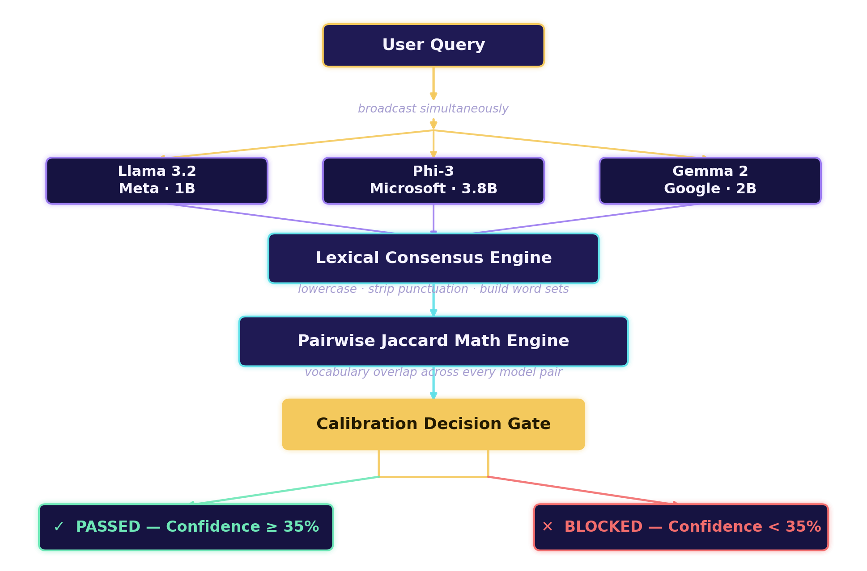
04 · THE CONSENSUS GUARDRAIL
The Consensus Guardrail Pipeline
We strip away the model's ego entirely — independent systems vote on the data before it ever reaches the screen.
10

Slide 4
02 · THE MODEL CLUSTER
Why This Architecture Was Chosen
✦
◈
✤
Architectural Diversity
Zero Cost & Full Privacy
Small-Parameter Advantage
Different organizations, different datasets, different structural formulas — independent errors that don't overlap.
Ollama runs the entire ecosystem locally on a standard laptop — free, private, and infinitely repeatable.
Smaller models (1B–3.8B) are more calibration-error-prone — a worst-case sandbox. Fix this, and it works even better at enterprise scale.
05

Slide 5
03 · WHAT'S BEEN TRIED
Three Fixes That Fall Short
Each approach paved the way — but each carries a fundamental flaw that breaks down in real deployment.
METHOD A
METHOD B
METHOD C
Static Temperature Scaling
Self-Consistency Loops
Naïve Verbal Elicitation
How it works
How it works
How it works
Dampens raw output probabilities before the model speaks.
Asks the same model the same question 5× and votes on the majority.
Prompts the model to self-report a confidence score after answering.
Why it fails
Why it fails
Why it fails
Applies identical dampening to every question — can't adapt to difficulty.
Measures agreement with itself, not truth — confidently repeats memorized lies.
Triggers ownership bias — the model grades its own work and inflates the score.
06

Slide 6
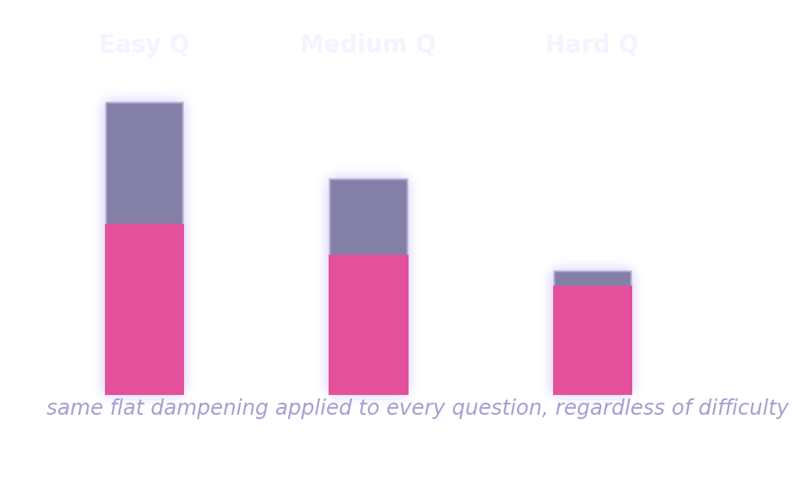
03 · METHOD A — TEMPERATURE SCALING
Static Temperature Scaling
Temperature controls how creative or predictable a model is. Researchers softened raw output probabilities before the model spoke — to make it “look” less certain.
One Setting, Every Question
The Flaw
It's a rigid, static fix — the exact same mathematical dampening applies to every question, regardless of difficulty. Ask “What is 2+2?” and the system artificially lowers confidence anyway. It cannot adapt to changing topics or real-world data shifts.
A confidence score that never moves with difficulty isn't measuring anything real.
Same flat dampening whether the question is trivial or genuinely hard — the confidence signal carries no real information.
07

Slide 7
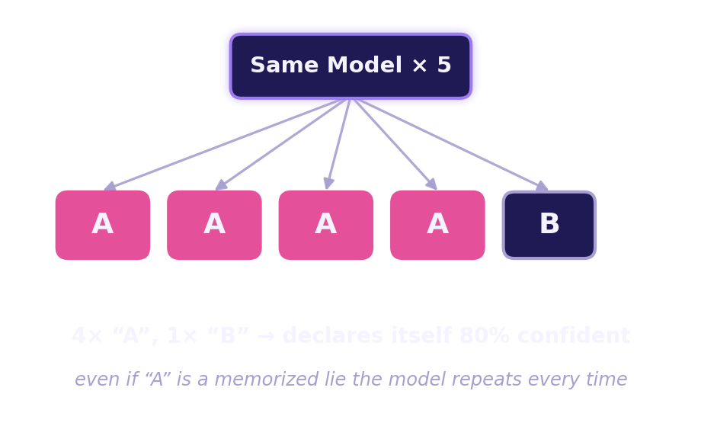
03 · METHOD B — SELF-CONSISTENCY
Standard Self-Consistency Loops
Ask the exact same model the exact same question five times in the background, then count how often the answers match.
The Flaw
This measures self-consistency, not truth. If a model has a deep, systemic hallucination baked into training — a firmly “memorized” piece of misinformation — it confidently outputs the exact same wrong answer all five times.
It fails to catch deep-seated memory lies — the one failure mode that matters most.
08

Slide 8
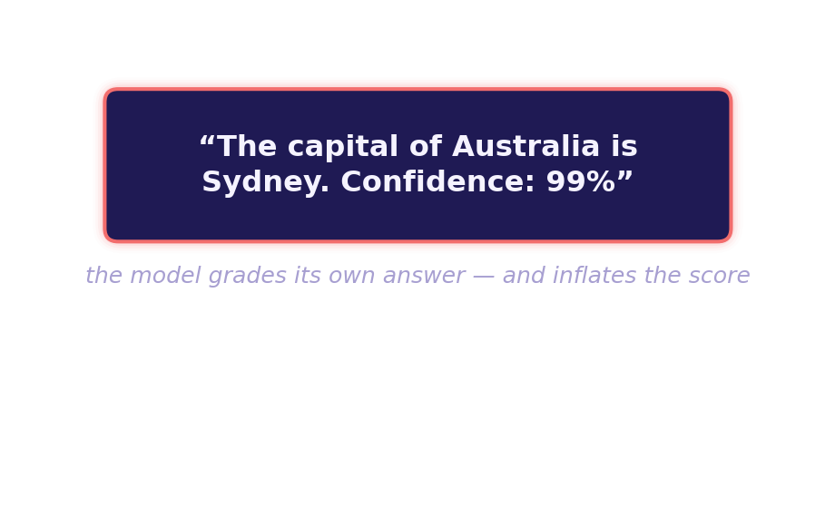
03 · METHOD C — VERBAL ELICITATION
Naïve Verbal Elicitation
Simply add a line to the system prompt: “Answer, then provide a confidence score from 0% to 100%.”
The Flaw
This triggers ownership bias. Once an AI writes out a full paragraph, its internal chat memory treats that text as absolute truth. Forced to grade its own writing, the model becomes defensive and inflates its score —
often rating a completely false answer as “99% sure.”
09

Slide 9
Thank you
14

